Slide 1

THRILL WP 3.4
Udo Eisenbarth, Yannik Zobus

Slide 2







Yet another optics simulation software ?
Existing solutions:
Proprietary licences
Not well-suited for large size laser systems (e.g. ghost focus calculation difficult)
Custom code hard / impossible to integrate
Our approach:
Open source
Platform for custom code integration
Extensible to specific needs
Model once – Use different analysis methods

Slide 3
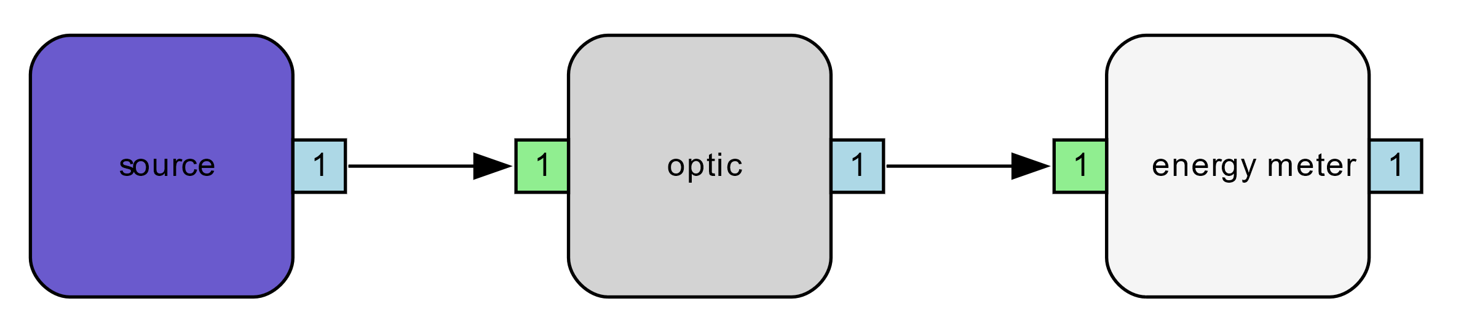
Simulation platform approach
Model arbitrary optical system as acyclic directed graphs
„light“ flowing as data between nodes
each node has a specific „analyze“ function
external code can be included as custom nodes
different analyzer modes: energy, raytracing, fourier, …
„light“ data
energy, spectrum, nearfield, phase, …
„report“ function
internal / external code, …
„analyze“ function
internal / external code, …

Slide 4

Software base
Software written in Rust
memory safety / efficiency,
speed
modern build environment
easy inclusion of external code (e.g. C/C++, Python, Julia, … )

Slide 5
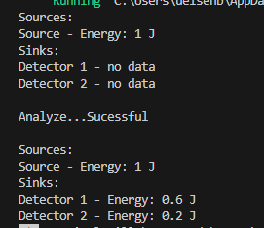
Example setup (filter system)
Input energy: 1J
60/40 beam splitter
50% filter

Slide 6
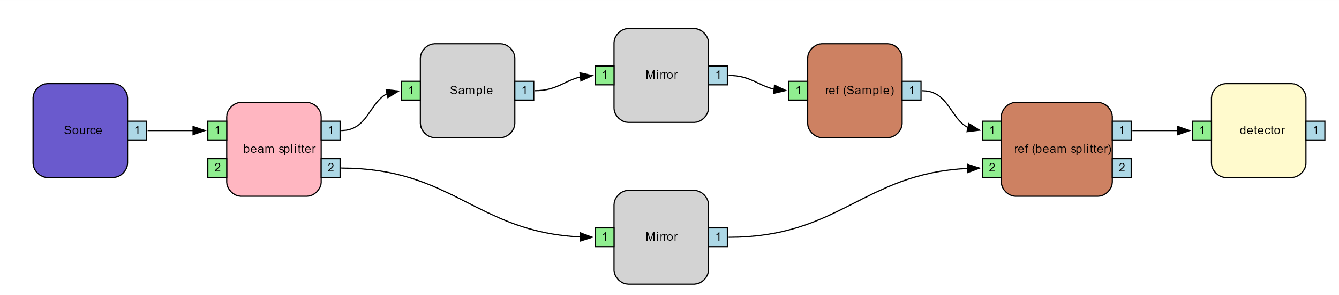
Example: Michaelson Interferometer
„reference“ nodes for
double-pass systems

Slide 7
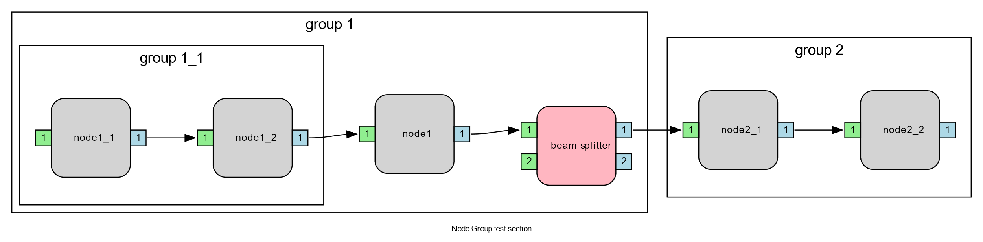
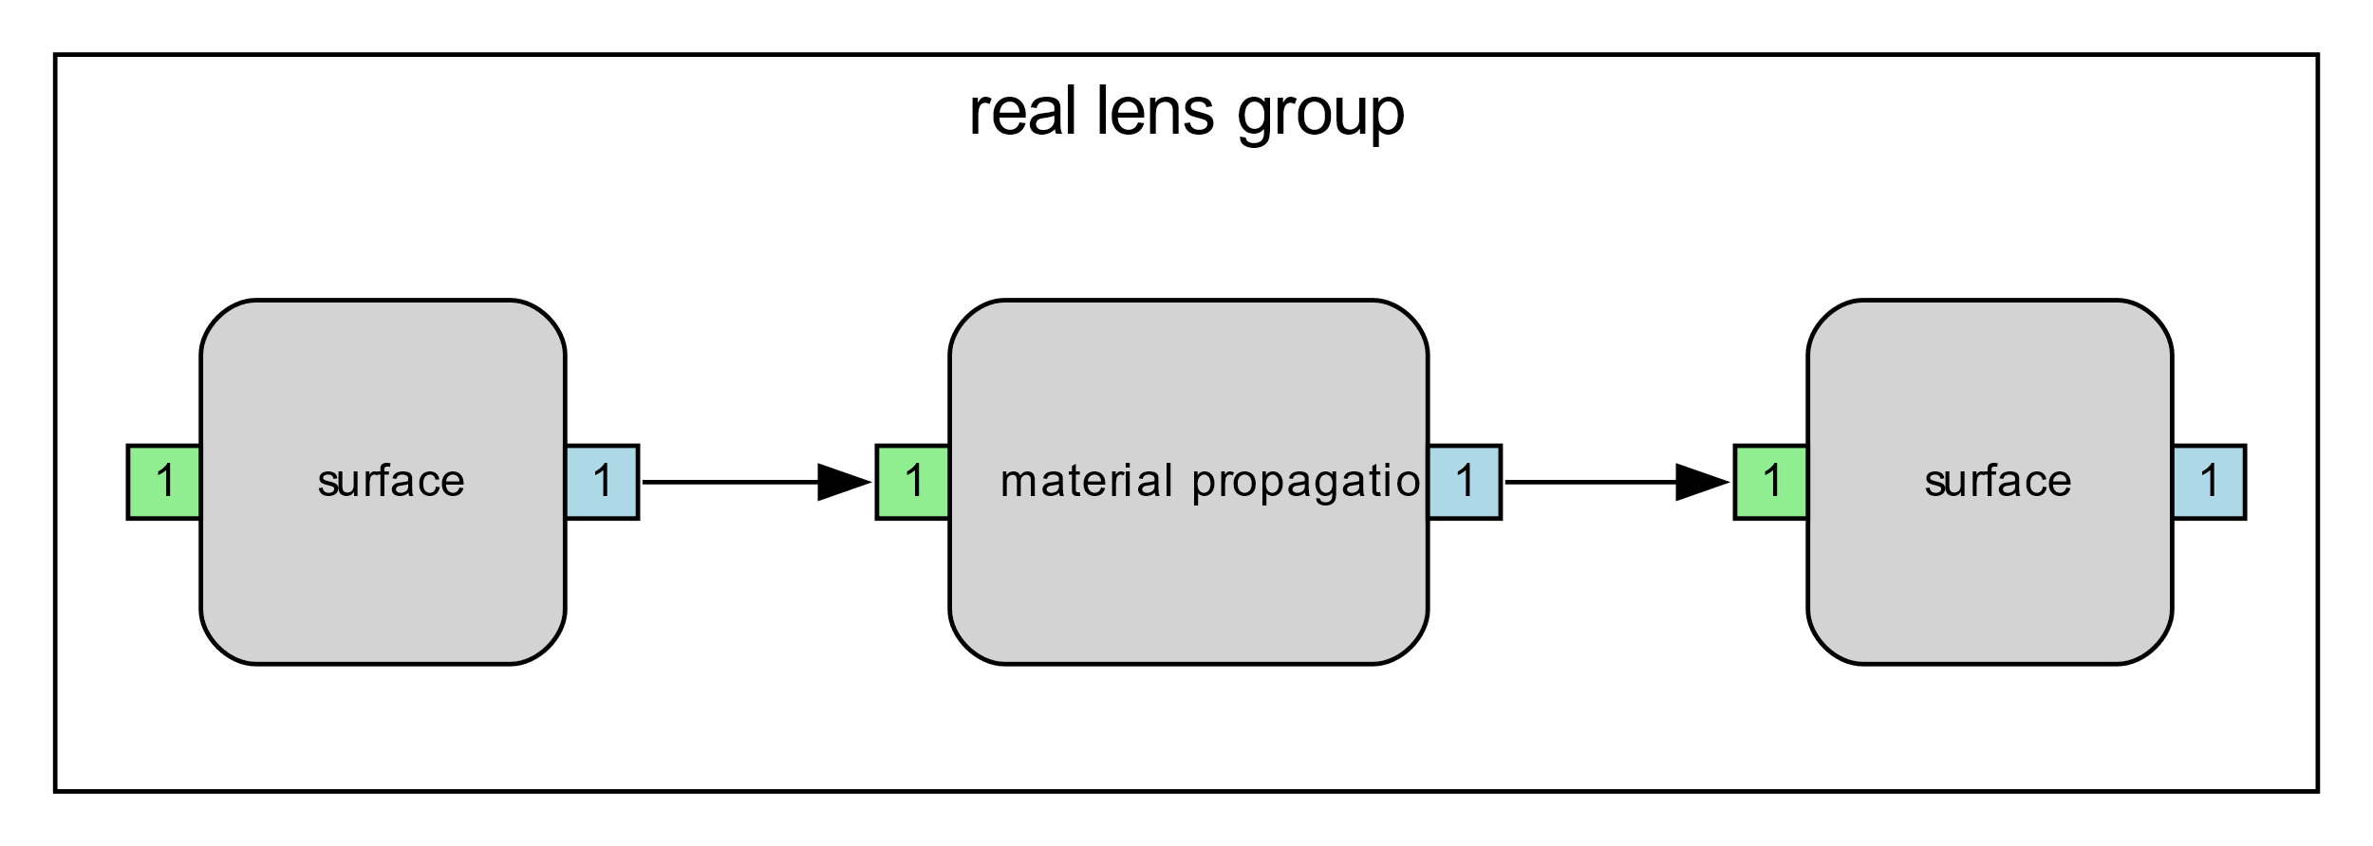

Node groups
Nodes can be grouped and infinitely nested
Example „real lens“

Slide 8
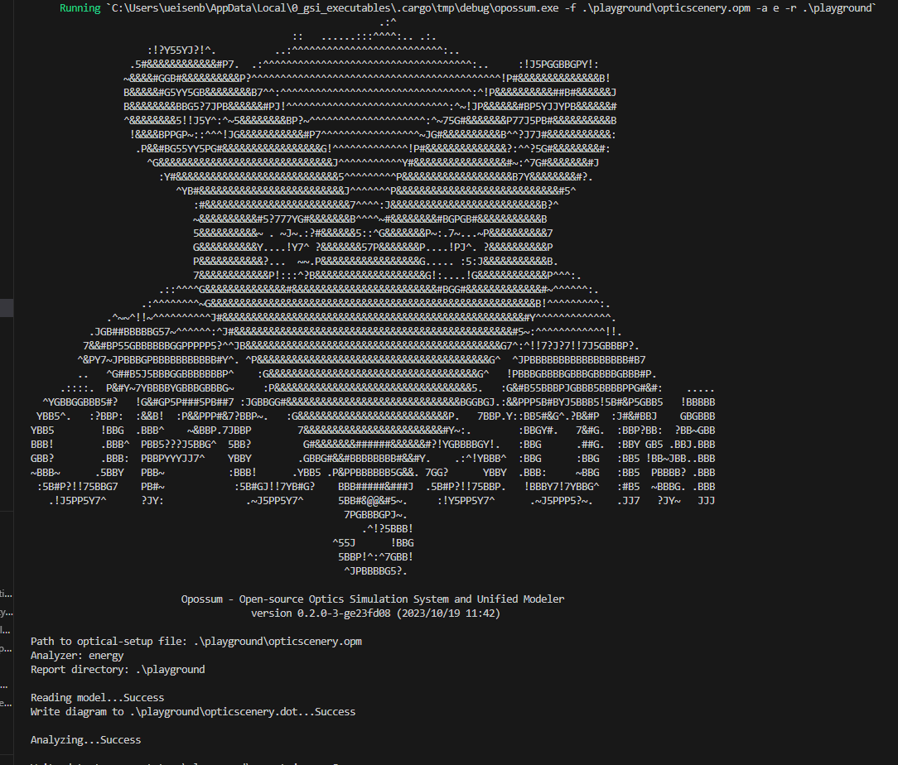
Project status
Project plan
Optical model concept worked out
OPOSSUM v0.2.0
technical concept preview (> 6000 lines of code)
very basic command line interface (CLI)
implementation of first simple nodes (source, detector, filter, beam splitter, etc..)
implementation of group & reference nodes
energy analyzer

Slide 9

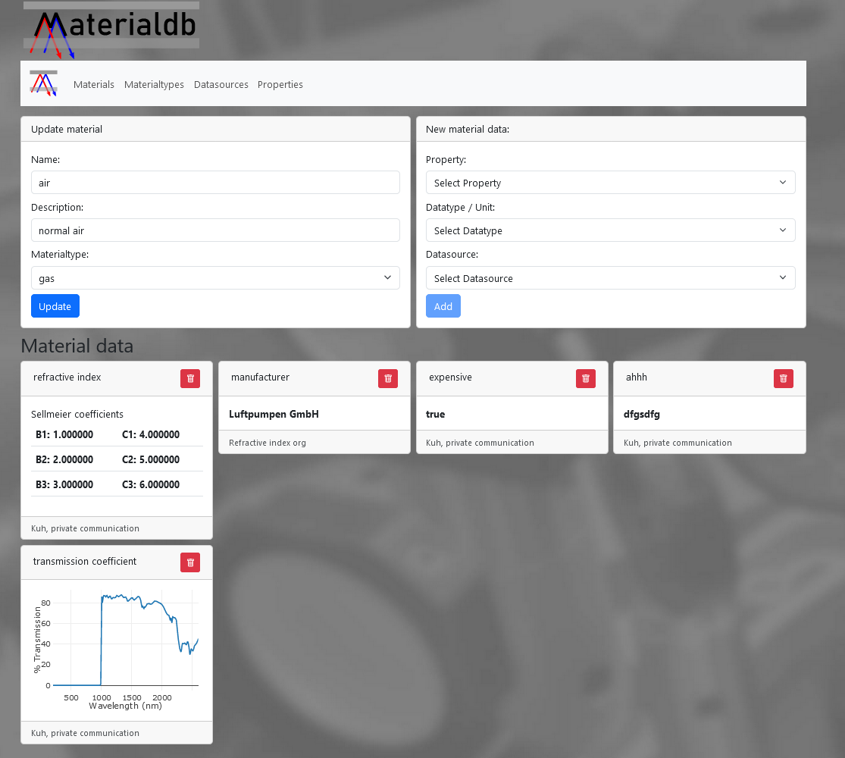
OPOSSUM ecosystem
database for arbitrary material parameters
db backend / web frontend architecture
first preview version available
OpticDB
database of standard optical elements
in conception / planning
OPOSSUM Reporter
generation of OPOSSUM analysis reports
in conception / planning

Slide 10
Outlook
planned milestones:
v0.3: implementation of basic ray tracing (wavelength and polarization dependent)
v0.4: inclusion of first external code (Python module: SHG simulation by M. Malki)
v0.5: connection to Materialdb, ?

Slide 11
Simulating double-pass systems
Solution: „Reference nodes“
Does not work!
(would form a loop)
linked elements
(inverted)

